Slide 1
Ivanti – Our Approach to DEX and what is coming next
November 2024

Slide 2




CIO / IT-Ops
CISO / Security
Drive innovation
Streamline operations
Improve digital employee experience
Proactively manage attack surface
Limit vulnerabilities & threat exposure
Improve secure employee behavior & organizational culture
IT & Security Aligned
Reduce enterprise risk
Increase organizational resilience and efficiency
Improve employee experience & engagement
2
Notes:
<OK GUYS – HERE IS THE PUNCHLINE>
We see the convergence of priorities and goals between CIOs and Chief Information Security Officers or CISOs
We’ve been working with both organizations for a long time – and they’ve worked in silo’s historically
And you’ve all felt the pain of that separation of priorities… But that is rapidly changing
Organizations are now looking for a joining of forces between these organizations to create the best possible IT environments for employees AND the safest oveall envinronments for the enterprise
The combined effort – creates a new level of performance and security that will become competitive advantage for organizations

Slide 3
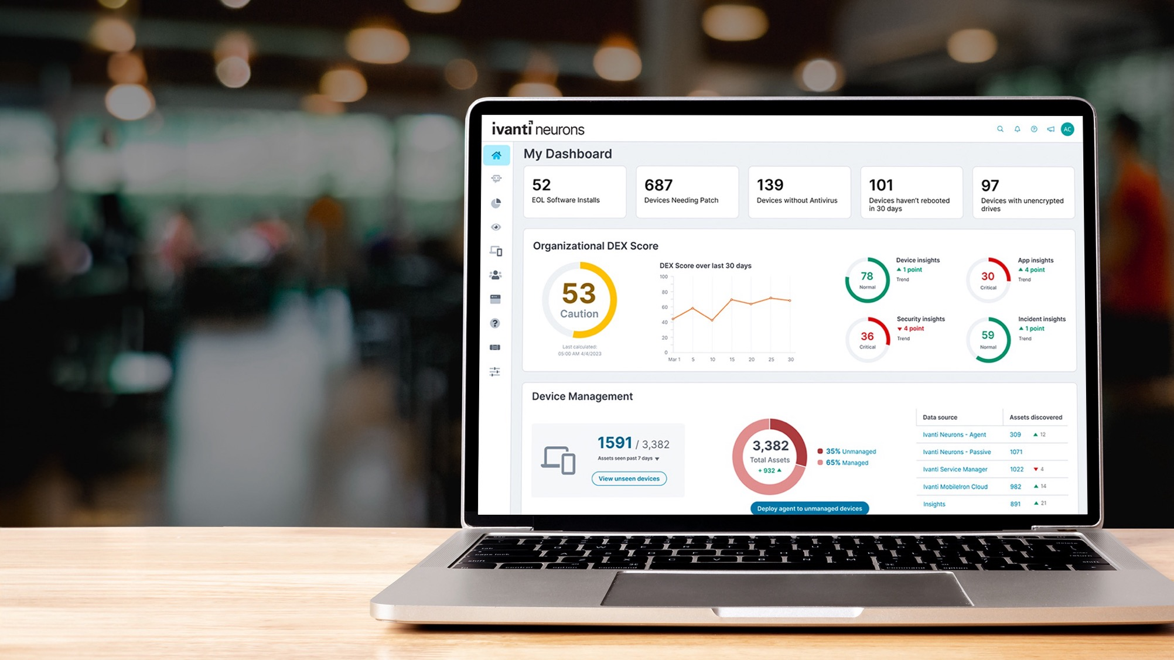

Ivanti is
the platform purpose-built
for IT & Security
Critical insights and data Elevated employee experiences
Intelligent AI and automation
Copyright © 2024 Ivanti. All rights reserved.
3
Notes:
After the acquisitions and maximizing the functional depth of each of the IT/Security solution pillars we provide – Ivanti is now delivering on the promise of our vision
Ivanti is now launching the platform that will help you achieve everything we just discussed
Let’s face a reality –
The CRO has Saleforce
The CFO has SAP
The HR executive has Workday
What does the CIO or CISO rely on you manage their business?
You’ve had to pull together a dozen, sometimes more, desperate solutions to do your jobs
THAT IS WHAT IS DRIVING US… WE ARE CREATING THE MARKET’S FIRST COMPREHENSIVE PURPOSE BUILT PLATFORM SOLUTION FOR CIOS AND CISOS
<Guys this is moment we’re driving for the “yea, where’s my go-to solution??”>

Slide 4







Platform Services Capabilities
Ivanti
Secure Unified Endpoint
Management
Enterprise Service
Management
Vulnerability Management &
Response
Zero Trust
Network Access
Cyber Asset Attack Surface
Management
One Ivanti Login, User Management & RBAC
Unified Navigation & Landing Page
Unified Dashboarding & Analytics
Ivanti Neurons Shared Platform Capabilities
SaaS Ready
Built-in Scale
Accelerate Migration
Hyper-Automated Resolution
Centralized Control
Notes:
Phil –
Enabling the solution packages that support these outcomes is our full portfolio of capabilities, which provide
Core IT service and asset management
Line of Business toolsets to enable customers to extend service management to non‑IT workflows
DEX, AI‑powered machine learning and automation
The ability to deliver deliver intelligent service management across the organization

Slide 5

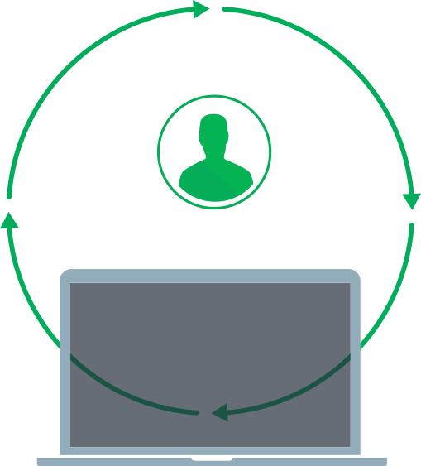
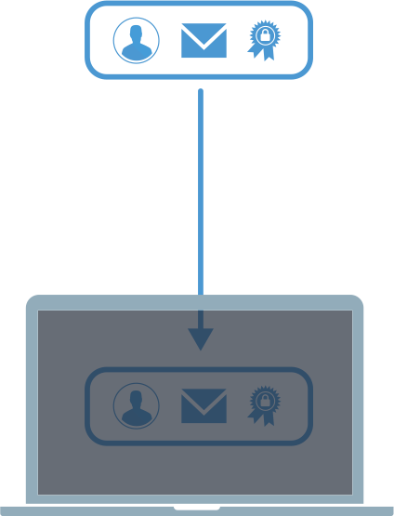
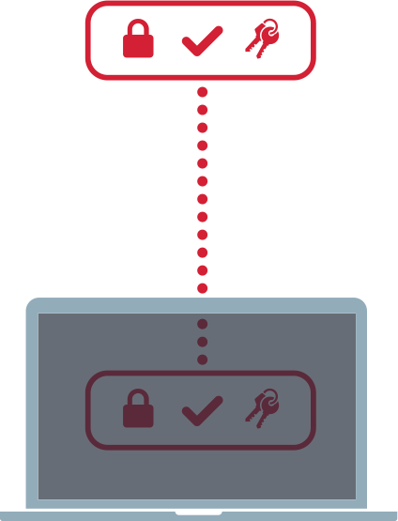
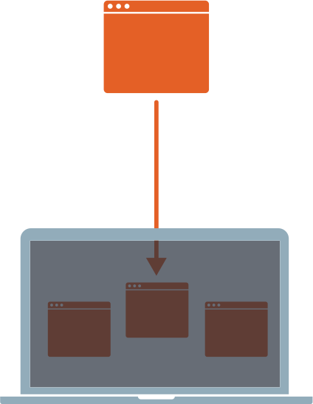





End-to-end Secure Unified Endpoint Management
Discover
Manage devices
Secure devices
Users
The visibility
Visibility in real-time using active and passive scanning
and third party
connectors.
Normalized asset inventory data, software usage information and actionable insights to feed CMDB*.
The foundation
End-to-end device lifecycle management & security.
Broad management use cases including frontline workers, contractors and BYOD.
Foundation for endpoint security.
Cyber Hygiene
Secure devices and applications with risk-based patch intelligence, patch management, and mobile threat defense
Productivity & user threats
Eliminate passwords with password-less MFA zero sign-on.
Digital Employee Experience
Protect against mobile phishing attempts.
Discovery
Provisioning
Configuration
Assistance
App Mgmt.
DEX
Security
Active
Passive
3rd Party Data
Reconciliation
Normalization
Registration / Enrollment
Zero-Touch Agent
Deployment
De-register
End of Life
Profiles
Wi-Fi
Certificates
Access Control
Restrictions
Secure Configuration
Passwords
Lost Device
Real-time Diagnostics
Remote Control
Purchase/License
Distribution
Installation
Inventory
Configure
Secure
Update/Patch
Remove
Scoring
Monitoring
Productivity
Sentiment Analysis
Patch
Application Control
Device Control
Least Privilege
Passwordless MFA
Threat defense

Slide 6














Product Portfolio
Ivanti’s platform enables IT and Security to Discover, Manage, Secure, Service, and Automate critical workflows across all device types in a Single Platform
Endpoint
Client and Server
Windows / macOS / Linux /
OS Provisioning
Software Distribution
Support/Troubleshoot Tools
Remote Control
Data Analytics
Workspace
Physical or Virtual/VDI
Desktop Configuration / GPO Enhancements
User Personalisation
Roaming Profile Mgmt
Performance Mgmt
Windows Migration
Mobility
Cloud Mobile Mgmt & Configuration
Automated Enrollment, Secure app tunneling, Containerisation,
Secure tunneling access control
Supports iOS, Android, ChromeOS, Zebra, Honeywell, and
Oculus
Security
Mobile Threat Defense
Patch Management
Risk Based Vulnerability Mgmt
Application and Device Control
Endpoint Privilege Management
Secure Configuration Mgmt
Healthcare IoMT Security
Secure Access
VPN / Remote Access
Zero Trust Network Access
CASB/SWG
Network Access Control
Device Visibility
Application Delivery Controller / WAF
Zero Sign-On/Passwordless MFA
Aggregated Discovery
Service
Full ITSM / ITIL Support
AI-powered Self Service
Voice Automation
Change, CMDB & Release
HR and Facilities Management
PPM & Financial Management
Governance Risk & Compliance
Security Operations Management
Asset
Full ITAM
Hardware Asset Mgmt
Software Asset Mgmt
Software License Optimisation
Software Audit Defense
Asset Lifecycle Mgmt
Cloud | Edge | Premise | External
External Attack Surface
Service Mapping
Cloud Delivered
AI powered Platform
HyperAutomation
No-code/low-code
Active Discovery
Passive Discovery
3rd Party Discovery
Single Pane of Glass
Analytic
Dashboards
Device
Information
User
Information
Active Directory
Connector
Smart Advisors
Software
Insights
Discovery
Edge Intelligence
Healing
Workspace
Patch Intelligence
Spend Intelligence
Digital Experience (DEX) Scoring

Slide 7
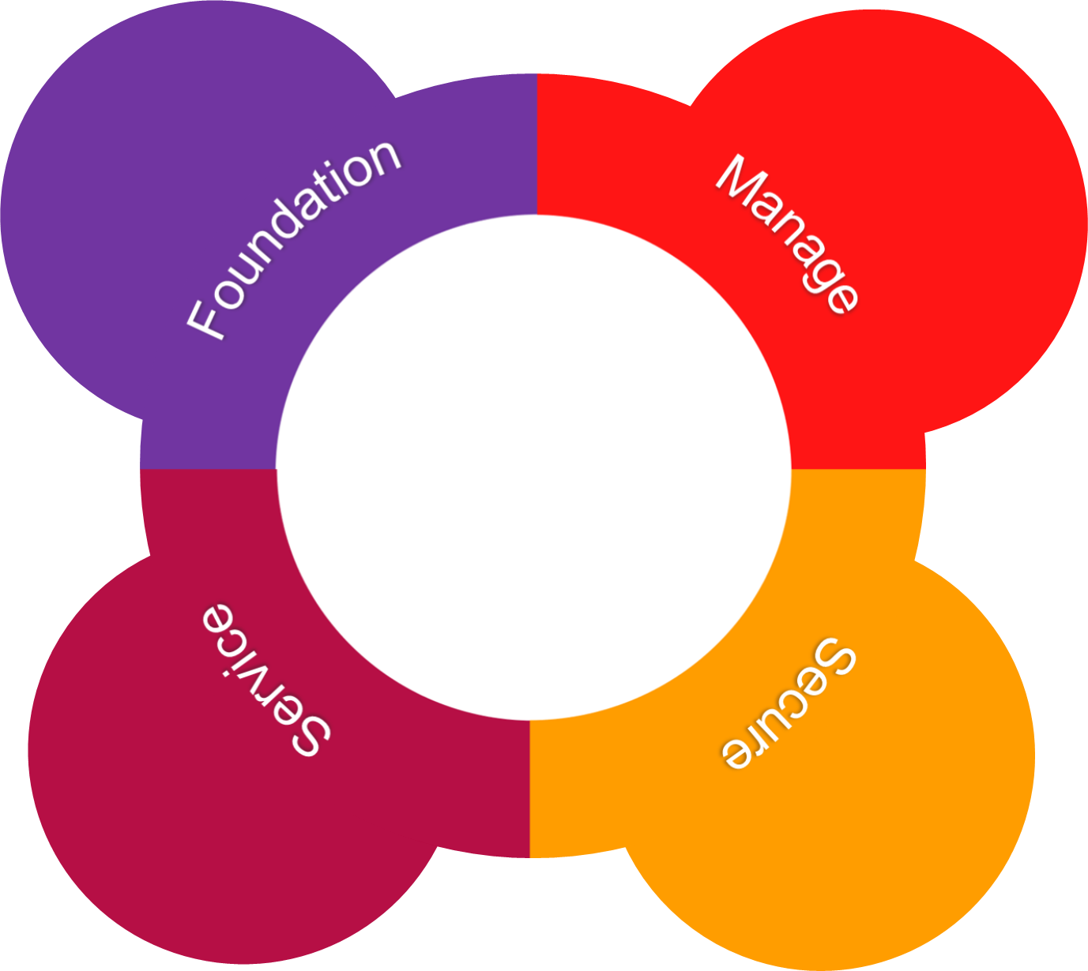
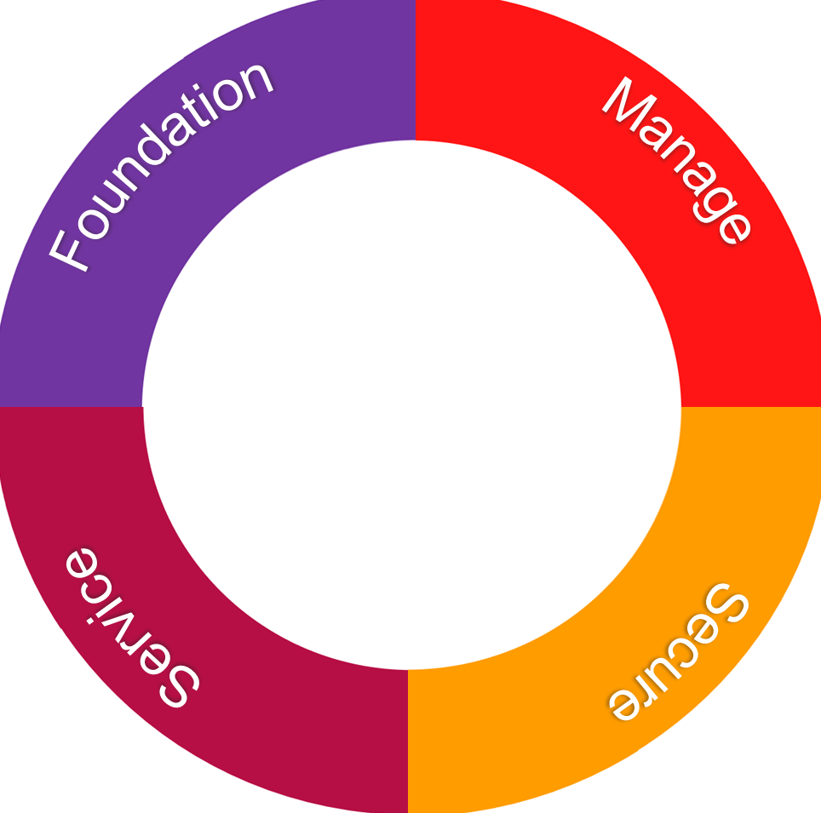

Discovery
Workspace
Healing
Endpoint Mgmt.
Modern Device Mgmt.
Mobile Device Mgmt.
User Workspace Mgmt.
Patch Intelligence
Digital Experience
Edge Intelligence
Spend Intelligence
External Attack Surface Management
Cloud based solution advantages
Eliminate hardware procurement and maintenance
Software maintenance eliminated
Agile deployment
Fast time to value
Secure and Resilient infrastructure
Continued enhancements
Medical Device Mgmt.
IIOT Device Mgmt.
Rugged Device Mgmt.
A cloud-scaled, intelligent automation suite of solutions that self-heals, self-secures, and self-services
Patch Mgmt.
Risk & Vulnerability Mgmt.
Zero Trust Access
Secure Access
IT Service Mgmt.
IT Asset Mgmt.
Software License Optimisation
Enterprise Service Management
Human Resources
Facilities
Project Management
Governance, Risk & Compliance
Mobile Threat Defense
Network Access Mgmt.
Web Application Firewall

Slide 8
Self-Healing Endpoint Management
Integrations
Integrations
Unified
Endpoint Management
UEM and DEX convergence
Leverage data and AI/ML to drive proactive endpoint management
Address measurement and continuous improvement of Digital Experience (DEX)
Automation handles majority of common endpoint management tasks
Reduce IT administration
Empower employee productivity
and innovation
Reduce Risk with security
views and remediation actions
Endpoint
Security
Digital Employee
Experience
Notes:
Endpoint management is definitely shifting.
Actually, this year was the last Gartner Magic Quadrant on Unified Endpoint Management.
It's now evolving into a kind of a new level of what's a combination of secure endpoint or unified endpoint management and digital experience together.
So more and more your endpoint management solution needs to have the management capabilities that have always been there blended with the security capabilities like device compliance, patching, mobile threat defense and other things like that.
Also layered on with the insights and telemetry to let you understand that digital experience and that's where where we're shifting to is really combining that you unified endpoint management capability with the endpoint security capabilities and that digital experience on top of it

Slide 9


Lifecycle of a DEX issue:
Opportunities to prevent, resolve and accelerate remediation of issues
Asymptomatic
Issue exists but is unknown
If left untreated
Intervention
Discover device issues, security vulnerabilities and measure productivity degradations and user impact
No Intervention by DEX
Digital friction, frustrated user
Interrupted work, decrease in productivity
Unsafe work arounds, security risk increases
without
DEX
tools
IT/service desk tickets increase,
IT overwhelmed
with
DEX tools
Issues don't get resolved quickly
Resolution
Improve digital experiences, decreasing IT demand and increasing productivity and user satisfaction
Stressed IT team, unhappy
employees, Vulnerabilities
increasing, new security
risks arising
Response
Recommend quick actions to remediate root cause
!
Notes:
Without a DEX solution, these disruptive issues that employees experience are left untreated. Without resolution, they quickly cause disruptions to productivity, user-frustration, and security risks arise. This all results in a stressed and over-burdened IT team, and increasing exploitable vulnerabilities creating more issues for security.
However, with the introduction of DEX, the issue has a different lifecycle.
Asymptomatic: The issue exists but isn't necessarily known yet, or not causing disruptions yet. Discover – surface top causes of device or application performance – device performance, security vulnerability, configuration drift
Intervention: With DEX there is immediate intervention, device issues and vulnerabilities are discovered quickly. Analyze – determine symptoms, root cause, possible resolution- storage, patch missing, no access ….
Response: Respond quickly with recommendations and automations that remediate the root cause of the issue. Recommend – provide recommendations on next best action to remediate issue. Approve – review and execute suggested remediation
Automate – initiate automatic remediation – elevate user access, turn on firewall, run user interaction, kickoff workflow
Resolution: After the issue is revolved the overall digital experience is improved, IT demand decreases freeing up time to focus on more strategic projects, boosting productivity and security posture.

Slide 10


Opportunities to prevent, resolve and accelerate remediation of DEX issues
Activity
Inoculation
(cyberhygiene +
experience guardrails)
“Prevent it from
becoming a problem”
Preventive
Maintenance
“Address emergent issues before they
impact users”
User Outreach
“Discover and
address unreported
digital friction”
Self-Heal
“Automatically respond
to issues that have
impacted users”
Self-Service
“Help users find
solutions to
their problems”
Analyst
Acceleration
“Reduce MTTR
and number
of escalations”
No user symptoms
Digital friction being experienced
Issue prevention
Issue response
Users
Service Desk
Ivanti Solution
Environment Mgmt
Performance Mgmt
App Control
Patch, SWD
Workspace
Bots
Bots Automation
Survey Bots
Healing Bots
Bots, SWD
10

Slide 11
Discovering your IT ecosystem

Slide 12



Neurons for Discovery – Visibility is key
Single Source of Truth
Connectors
Device Normalisation and Reconciliation

Slide 13


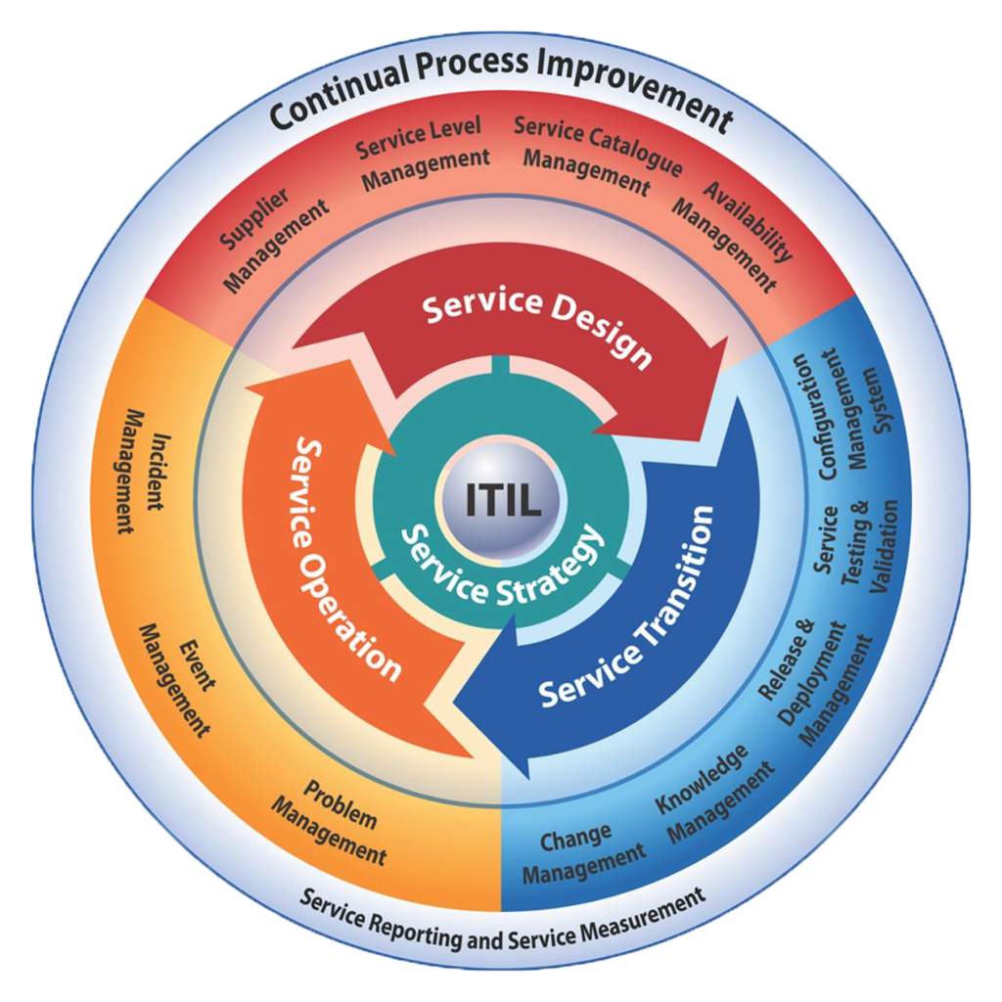














































Identity Solutions
IT Service Management Solutions
Data Centre Infrastructure
Security Solutions
File Import
Cloud Infrastructure
Connectors
Endpoint Management Solutions
MDM Solutions
End User Hardware
SaaS Applications

Slide 14
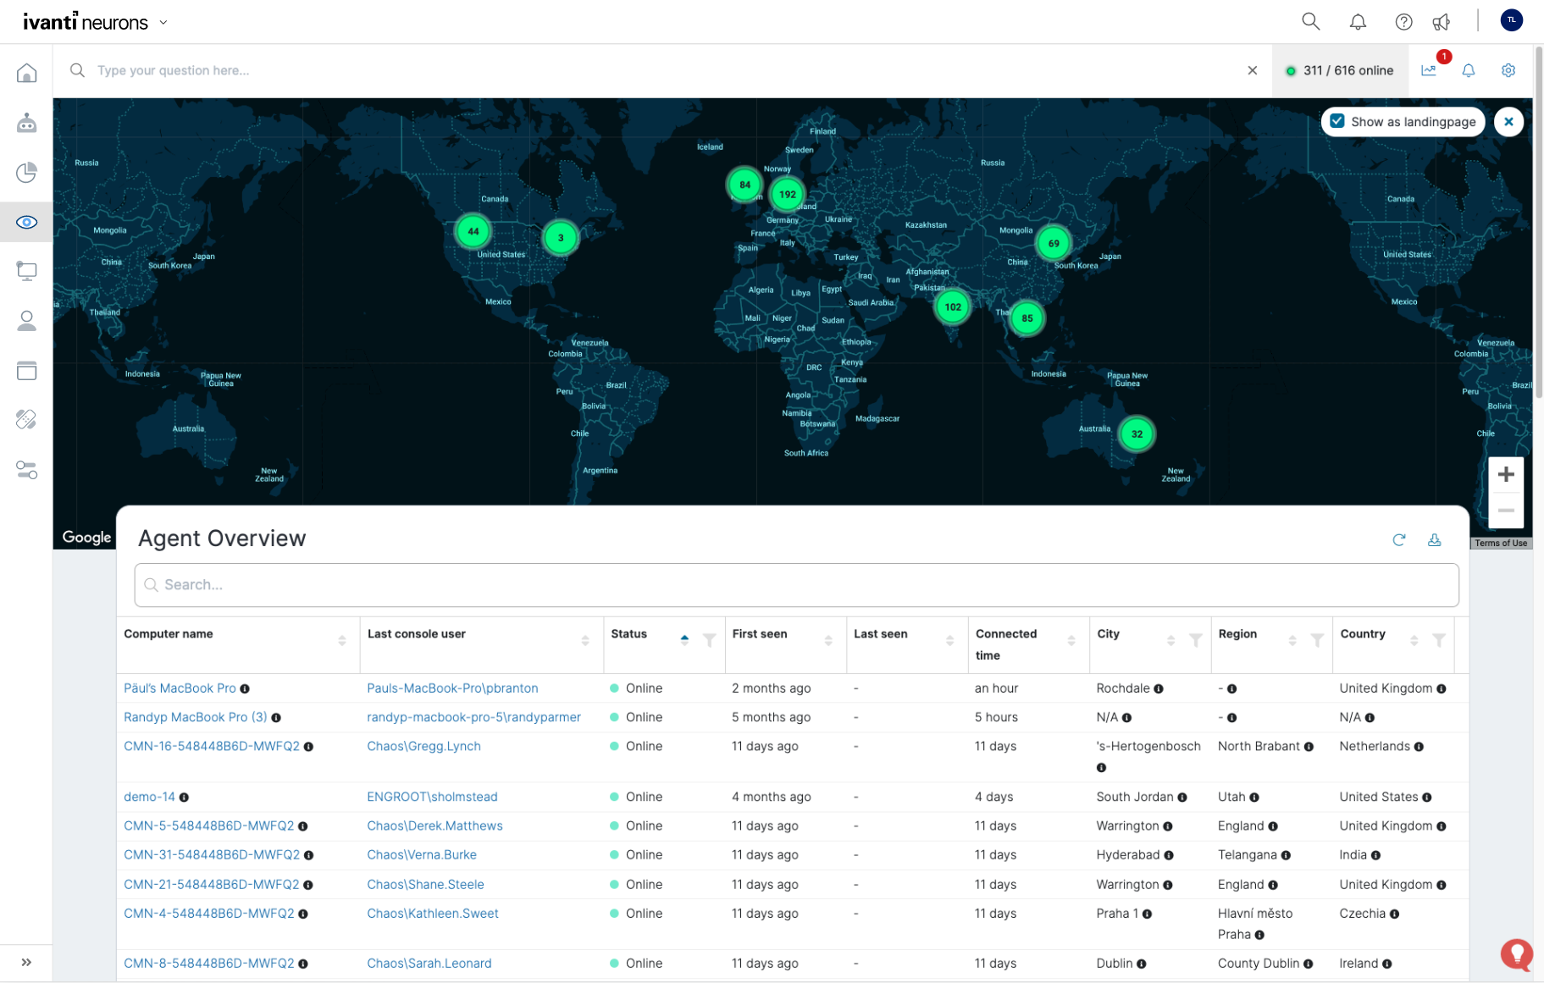
Ivanti Neurons: Edge Intelligence
Real Time Intelligence
Operational Awareness
Real-Time Sensor
Under 15 Seconds to Query all Devices
Sensor Based
Trending
Snapshots
Visualize Current State of Devices

Slide 15
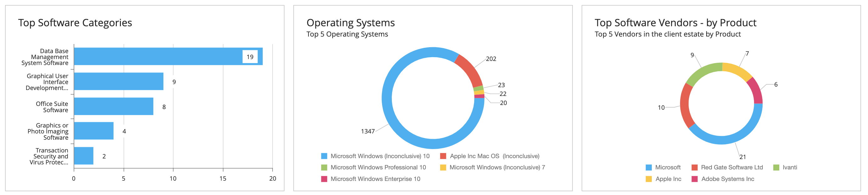
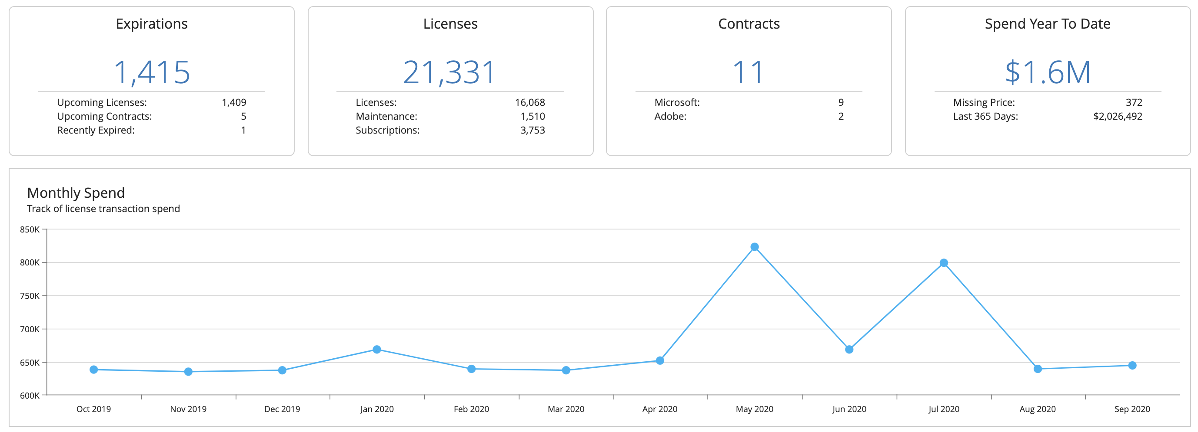
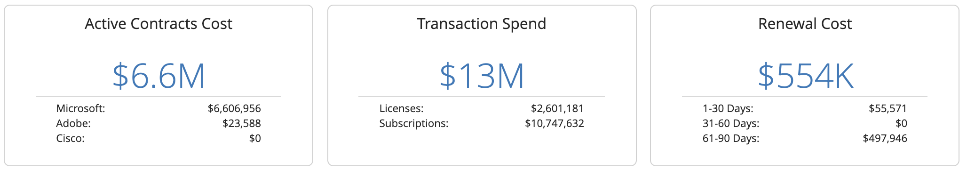
Ivanti Neurons: Software Estate
Software & Cloud Usage Insights
Software Inventory
Spend management
SaaS Usage
EOL Software Views
Contract management
Reclamation
Notes:
Discovered Software Management
Product Installations, Normalized against Software Library​
Installs, Usage, EOL, Prohibited​, Reclamation
Software Usage & Spend Management
Purchase imports​ (MLS and more)
SKU Library
Contract and License Spend Dashboards​, Renewals
Usage vs Purchase Comparison ​
SaaS
Microsoft, Adobe, SFDC & SSO integration
User and Usage view across any SaaS applications via SSO
Activity & Spend on MS, Adobe & SFDC
Intelligent Software Asset and Spend Management.
Insight, decision making and action to manage application usage and spend, from Edge to Cloud to Data Center
Ivanti Neurons for Spend Intelligence instantly provides insights into your software landscape and application spend for on-premises, cloud, and edge environments to help you improve operational speed and asset visibility, utilization, and costs.
Use case: In an average month we spend probably about 40 hours of productive time managing vendors, spend and dealing with renewals… For Microsoft EA true-up preparation lasts two months and takes about 120 hours of productive time to validate the numbers. However on a full contract renewal it will take 300+ hours of productive time.”
Neurons for Software Intelligence reduces the time and effort significantly.

Slide 16
Measure, Manage and Secure

Slide 17
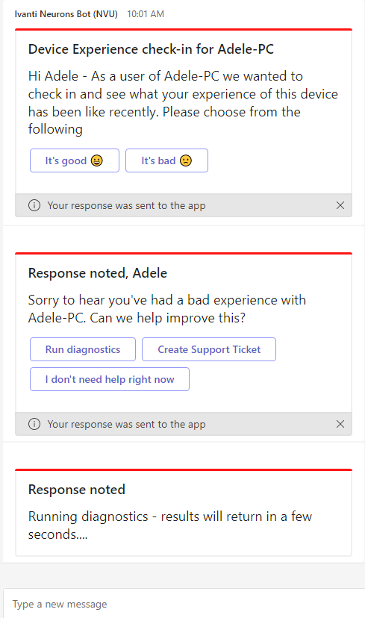
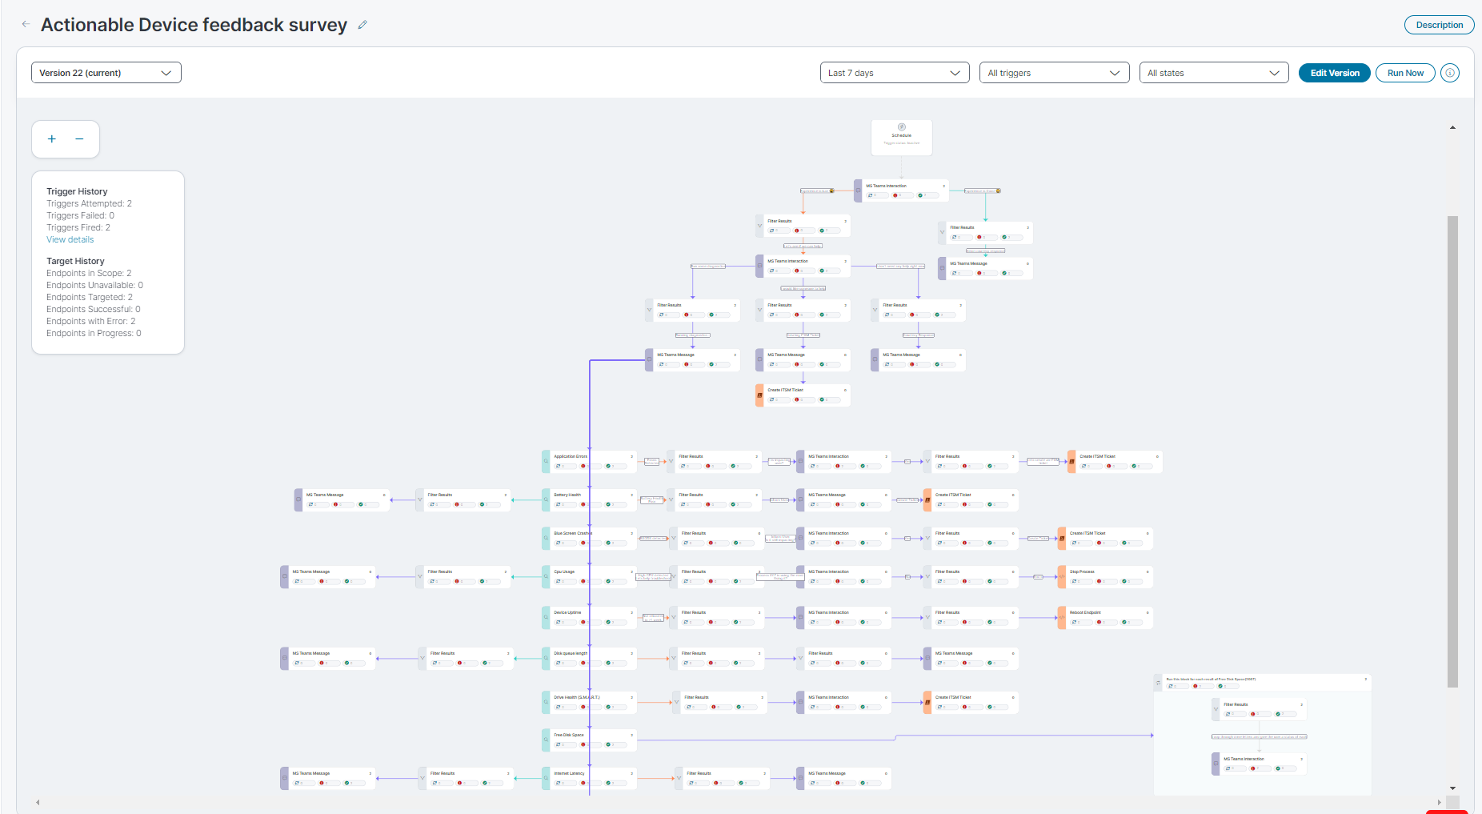
Qualitive Feedback: Interactive Automation Surveys
End User experience
No Code/Low Code bot editor
Notes:
Interactive MS teams. Gain insights and feedback from users

Slide 18
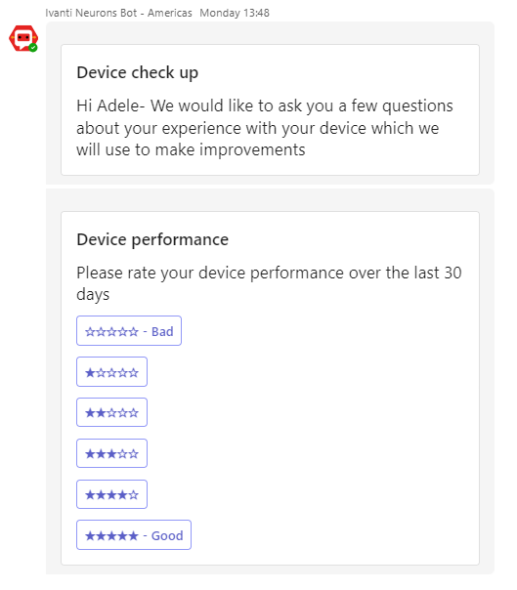
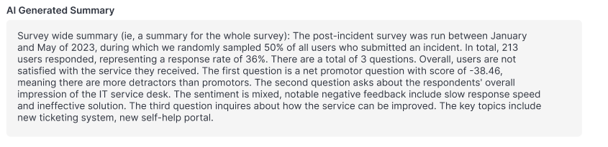
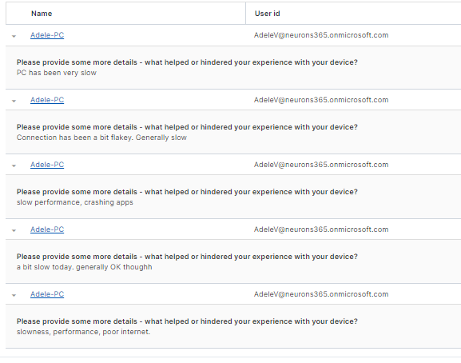
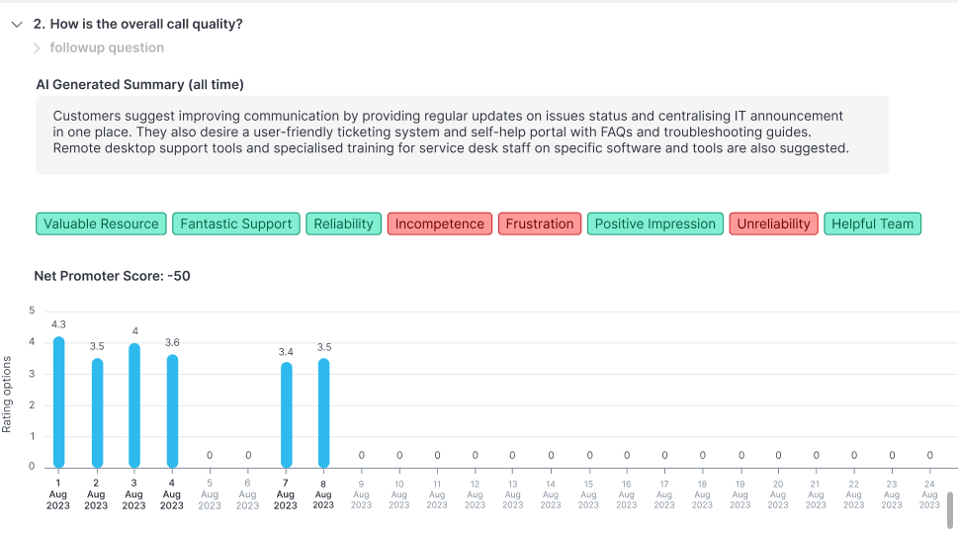
Generative AI
Step 1:
User provides rating
Step 2:
User explains rating in freeform feedback
Step 3:
Gen AI summarizes key findings from step 1 and step 2

Slide 19
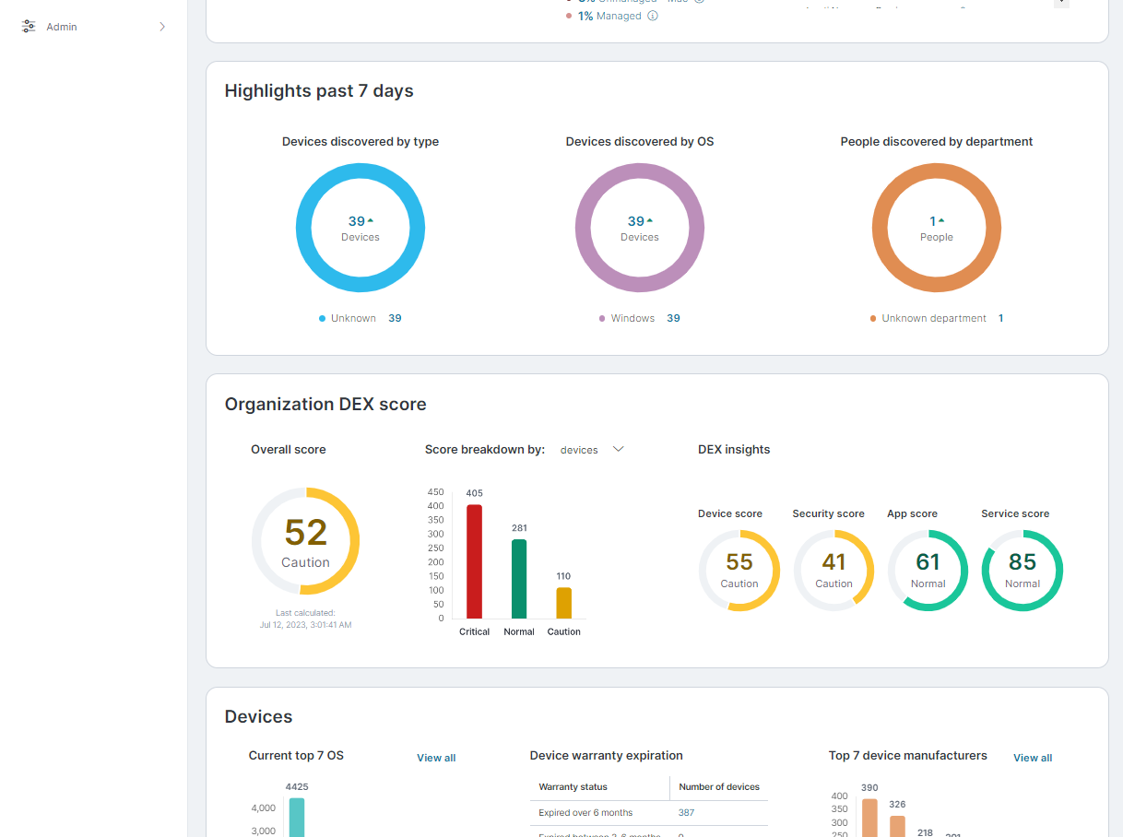
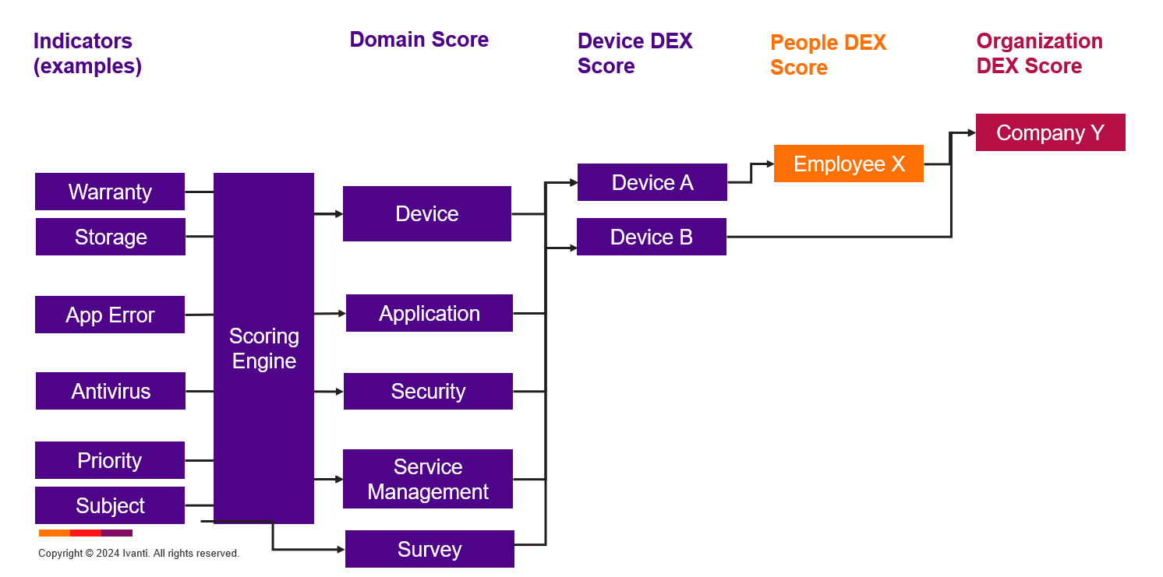
DEX Score
Track, measure and optimize digital employee experience
Algorithms Used
Anomaly Detection Unsupervised machine learning model using historic device data to identify deviation from norm Statistical Model Mean and standard deviation of historic device data are used io standardize metrics into scores Sentiment Analysis Pre-trained sentiment analysis service is applied to open tickets to gauge sentiment of employees
Notes:
22 and 23 SE feedback on

Slide 20
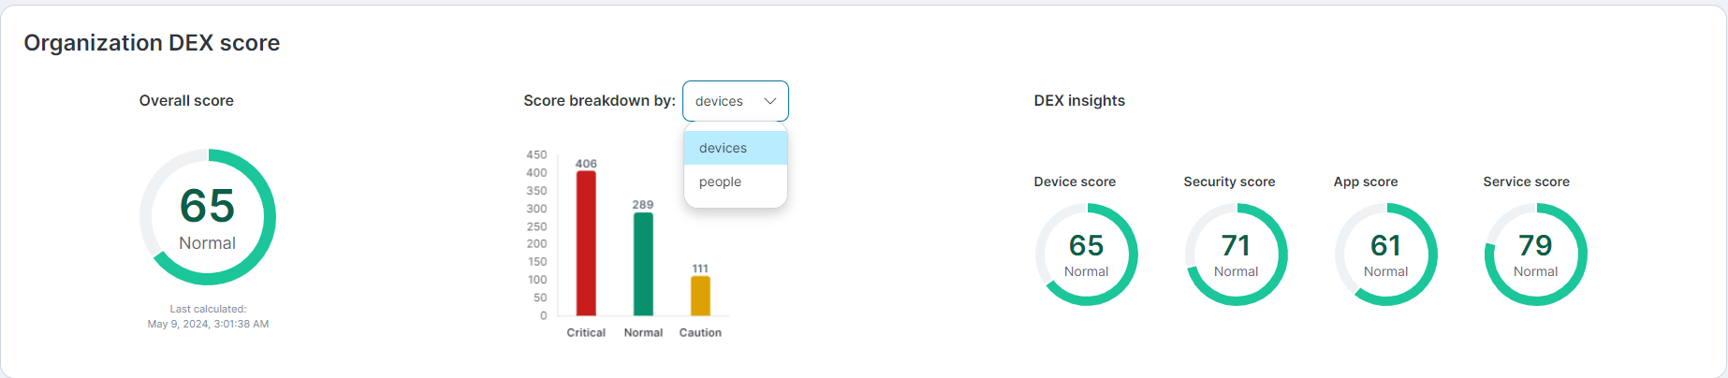
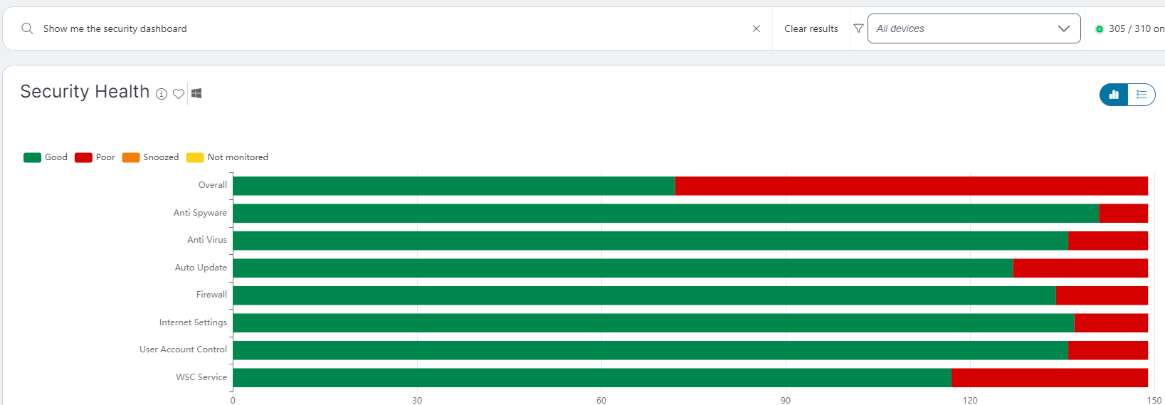
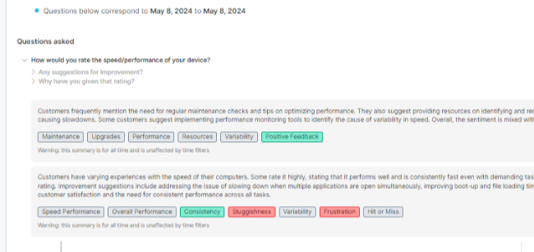
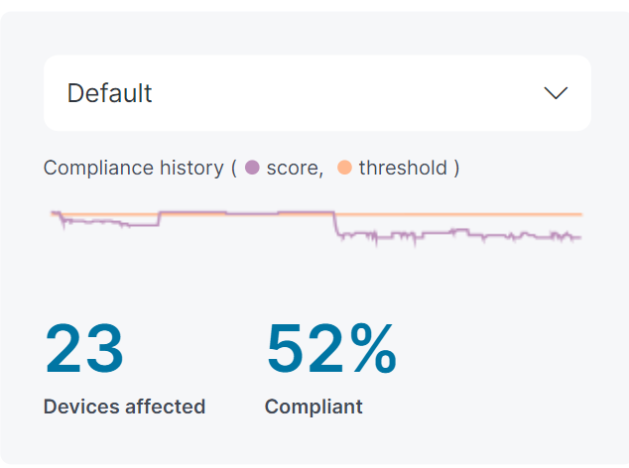
Prioritizing and recommending actions to address anomalies
Landing page KPIs
DEX score / Survey
Edge Intelligence
Fleet wide view of key metrics such as
Missing AV
Low Disk Space
EoL software
Missing Disk Encryption
Devices with BSODs
Devices with known vulnerabilities
Compliance reports
Identify users or devices with low DEX score
Drill down to recommendations
Automatically or manually target with bots for diagnostics, remediation or sentiment assessment via survey
GenAI powered survey analytics
MQTT powered edge sensors
Categorised results to identify anomalies
Historical context with trends over time
Inline remediation or leverage in bots low-code/no-code
Drill down from quantitiave to qualitative views
Chain sensors for root-cause analysis

Slide 21

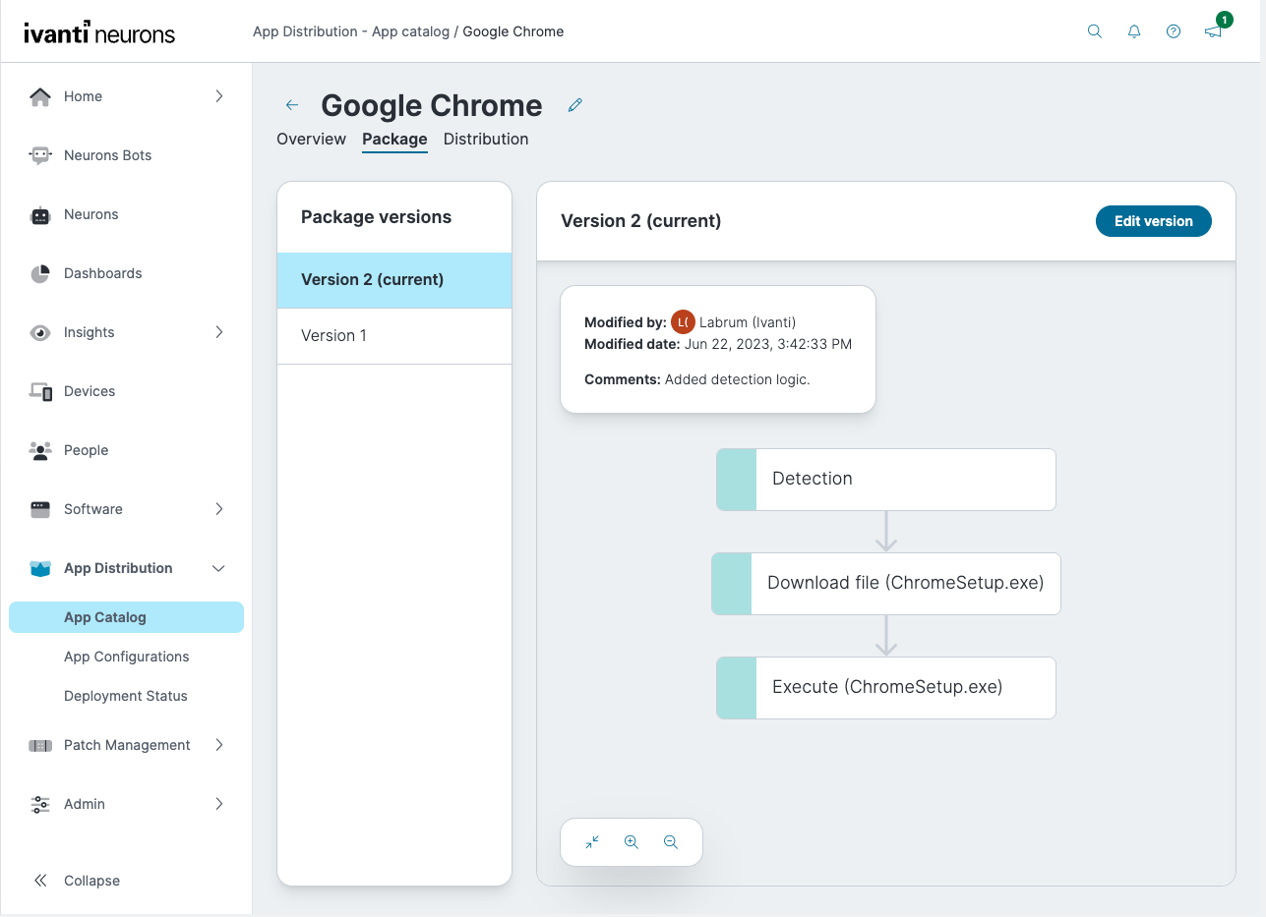
App Distribution – Ensure users have the apps required for productivity
App Distribution from the cloud, available as part of Ivanti Neurons for Digital Experience
  Easily deploy applications to your users' devices
    Mass & 1:1 deployment
    Custom & complex applications
    Target groups (Neurons or AD) or individual devices
    Workflow editor for simplified package creation
    Version tracking
    State management
    Custom script support
    In-app troubleshooting & distribution status
  Perpetual app deployment detects and pushes the latest app packages so you can ensure your apps are always up-to-date and secure
VIDEO
Notes:
https://youtu.be/QMan6Lm5gRE

Slide 22
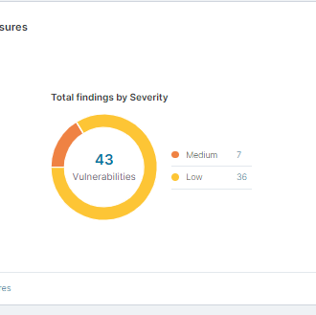
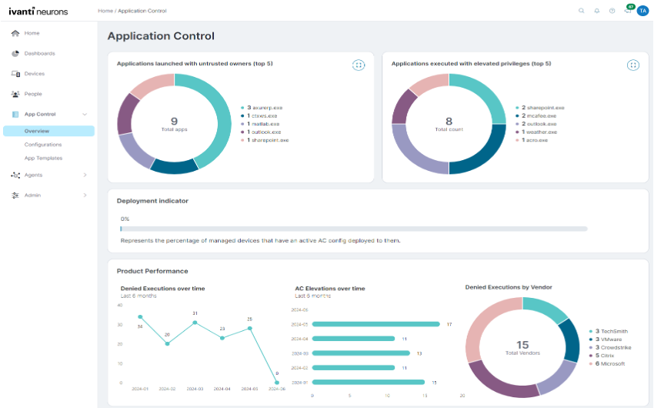
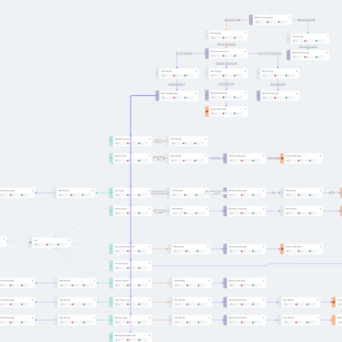
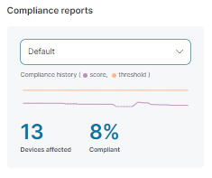
Insulate against DEX issues with Security and Compliance capabilities
Patch Management
EASM / Exposures
App Control
Bots
Patch Intelligence
Compliance Reports
Cloud-native cross-platform patch management
AI powered insights
External attack surface mgmt.
View assets with exposures
Prioritisation of vulnerabilities
Trusted Ownership with allow and deny apps and files
Audit and restrict modes
Elevate on demand
App templates
Drill through data to easily create rules
Automate cyber-hygiene
Automate reports
Orchestrate user outreach
Enforce compliance
Notes:
-add app control as additional column
Remove edge replace with AC

Slide 23
Proactive Resolution and Self-Heal

Slide 24
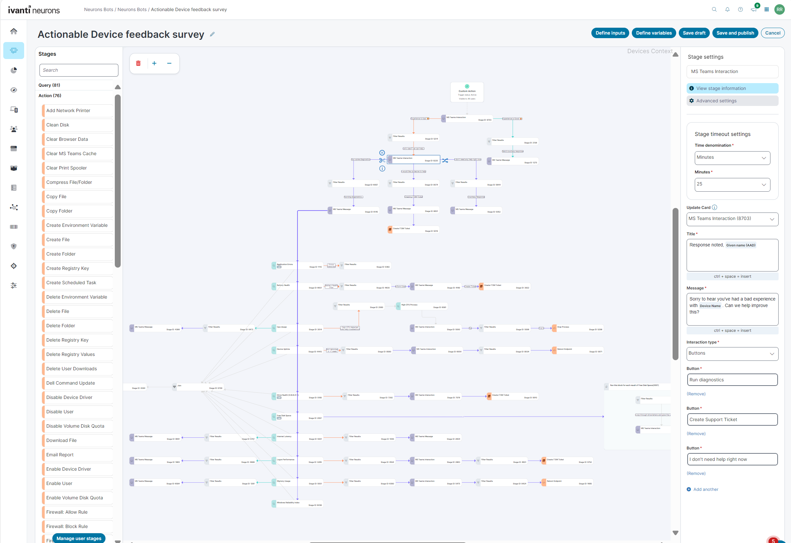
Ivanti Neurons: Healing
Low-Code/No-Code Automation for App Distribution, Sentiment Collection, Issue Prevention and Self-Heal
Hundreds of stages and bot templates
Low Code / No Code
End-User interaction / Self service
Device and People contexts
Inbound and outbound API Integrations
Actionable surveys with GenAI summarization
Real-Time, Scheduled or API driven
App Distribution Content

Slide 25
Real-world bot use case examples
Cyber Hygiene
Issue Prevention
Self-Healing
Routine Reboots
Remove unexpected local admins
Clean out unused user profiles
Identify devices with missing disk encryption
Devices with out-of-date/missing Antivirus
Location compliance
Remediate low disk space
Upcoming certificate expiry
Battery degradation response
Devices with predictive disk failure
Post patch actions
UWP / browser / DNS cache clean-up
Heal Hosts File
Trigger Time sync
Heal stopped / crashing services/processes
Install missing 3rd party agents
Deploy/repair/clean up VPN software
Resolve printer issues
Observability
Analyst Acceleration
Administration
Device experience survey
Green IT Survey
Devices with DEX issues
Synthetic monitoring
Login and bootup times
Remote vs Office device report
Devices with AD trust errors
Run Diagnostics suite and report findings
Test and report device performance
Repair MS Office
Clear print spooler
Create and populate ITSM ticket with diagnostic info
Install/Uninstall software
Message user(s)
Enrol device in MDM
Windows 11 Compatibility
Remove legacy management agents
Trigger OS update
Network drive mapping
Fast Startup configuration
Trigger software installation

Slide 26
Recommendations and intervention

Slide 27
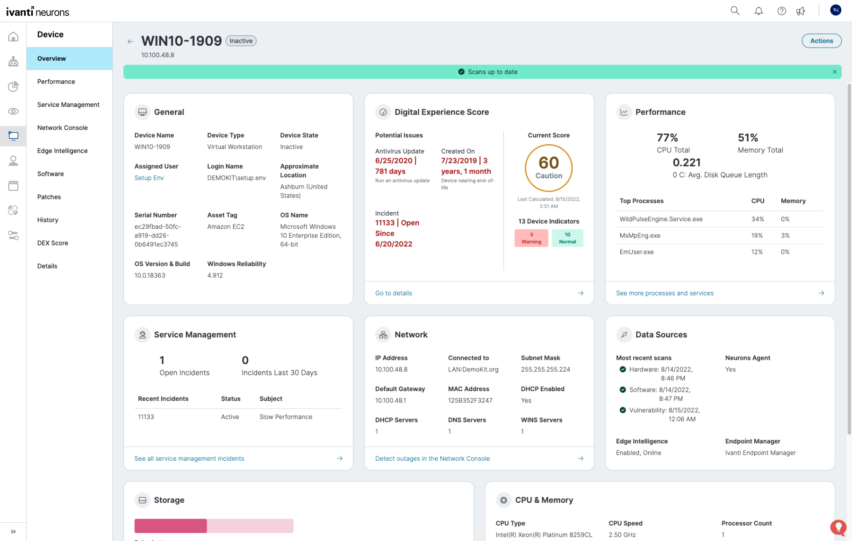
Ivanti Neurons: Workspace
IT Analyst Workspace for a 360° view
Reboot
Real-Time Data
Remote Control
Device Actions
Password Reset
Aggregated Device and People Views
DEX Score

Slide 28
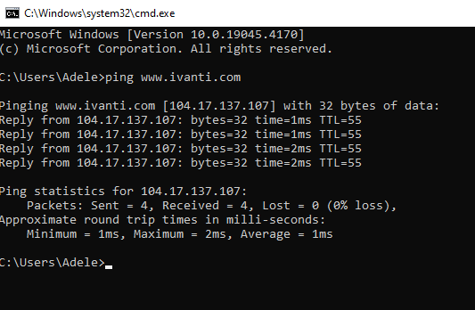
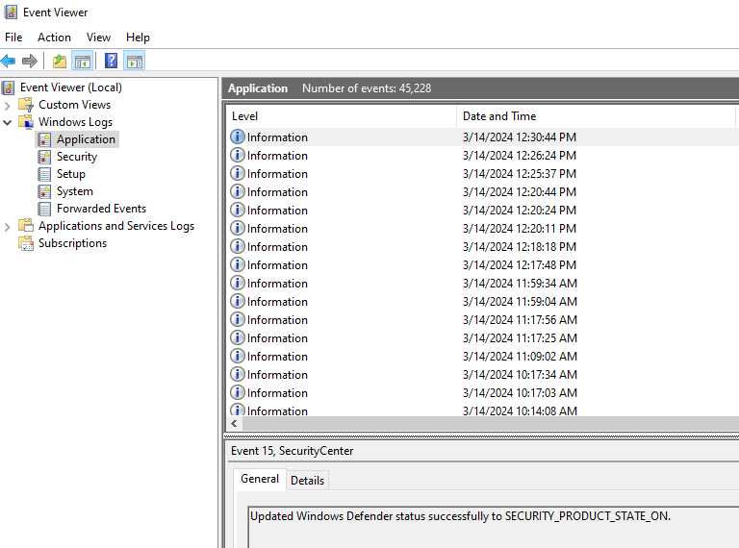
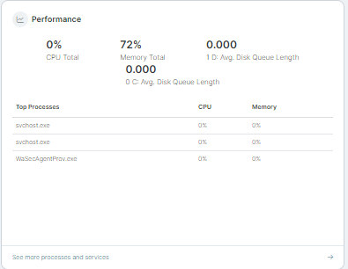
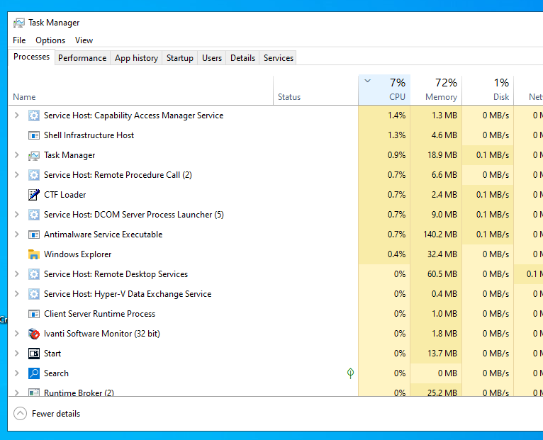
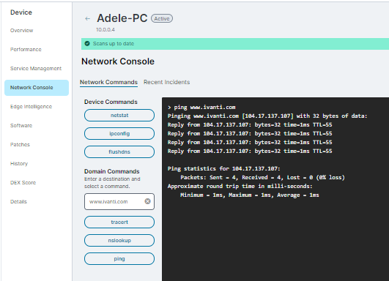
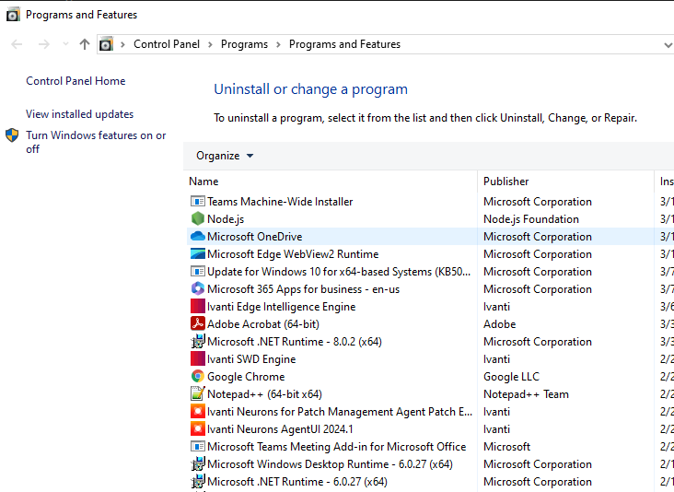
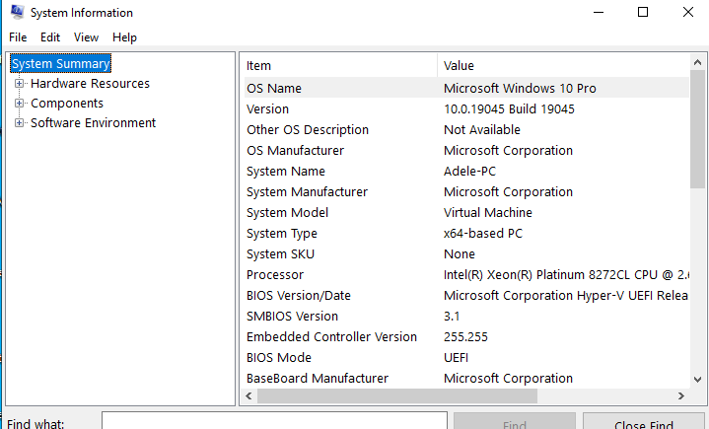
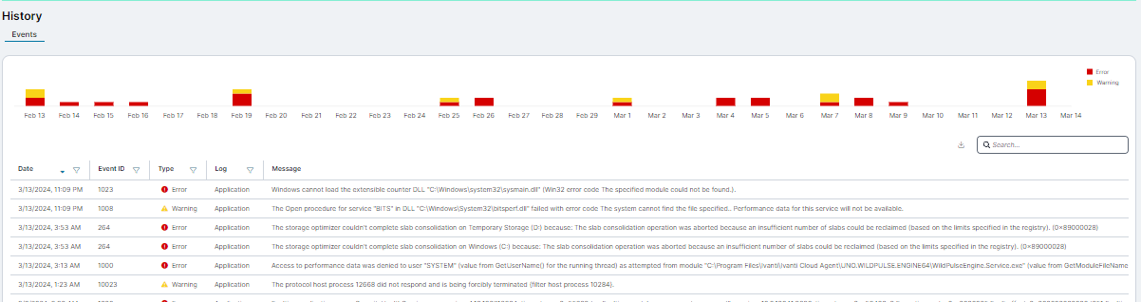
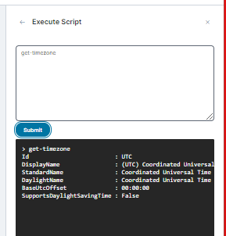
Democratised data means.. Turbocharged support
Traditional: disruptive, slow and inefficient
Workspace: zero impact troubleshooting, optimized
Remote control device
Use command prompt, Task Manager, event viewer, Programs/features, msinfo32, services and PowerShell to troubleshoot
Troubleshoot out-of-band and invisibly to the
end user with comprehensive troubleshooting and automation tools for both device and user account issues
Remote control (agent and agentless) is available if required

Slide 29
2025 Roadmap themes

Slide 30








2025 Ivanti Neurons DEX Themes
UX/Analytics
Automation
Integrations
Risk
Unified Login and portfolio landing page enhancements
Dashboard designer enhancements
DEX score enhancements
Self Service
New content
Patch orchestration
Additional beyond-device automation
ServiceNow Outbound connector
Additional 3rd party connectors
Virtual Vulnerability scanner
Vuln scan reconciliation
Cross-product
App Distribution
Platform
App Control
Tighter service management coupling
Unified RBAC enhancements
Preferred server
Package dependencies
Phased rollout
OS Provisioning
Dynamic agent policy
Enhanced agent controls
Comprehensive device &OS support
Additional sensors
Process Rules
Self-Authorisation
UX enhancements

Slide 31
Thank you

