Slide 1

Democratising IT Data
Research Report Findings & Stories from the Trenches
Eric Mc Gee

Slide 2


30 years experience
Electronic Engineer
IC Designer
Systems Engineer
Cyber Security Solutions Consultant
Managing Executive at large System Integrator – Networks and Security
Associate Director Cyber Risk at Deloitte
Ivanti Sales Engineer
About me
Copyright © 2024, Ivanti. All rights reserved. 2024 Democratising IT Data Report. 07/24 DH

Slide 3
This report is based in part on two surveys conducted by Ivanti in late 2023 and early 2024: “2024 Everywhere Work Report: Empowering Flexible Work” and “ 2024 State of Cybersecurity: Inflection Point.” In total, these two studies surveyed 15,000 executive leaders, IT professionals, security professionals and office workers. This report looks specifically at the 3,059 leaders, IT professionals and security professionals surveyed across the two studies.
These studies were administered by Ravn Research, and panelists were recruited by MSI Advanced Customer Insights. Survey results are unweighted. Further details by country are available by request.
For more Ivanti research on IT, security and the future of work,
visit ivanti.com/research.
About the research
Copyright © 2024, Ivanti. All rights reserved. 2024 Democratising IT Data Report. 07/24 DH

Slide 4
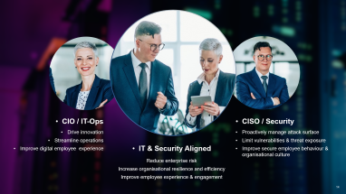
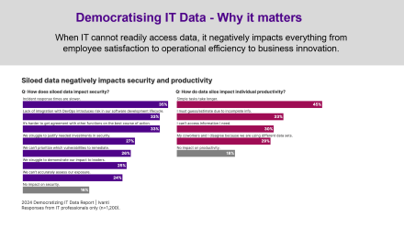
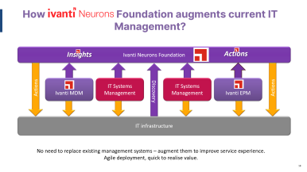
My storyline
How Democratise?
Why Democratise?
How Ivanti can help?

Slide 5
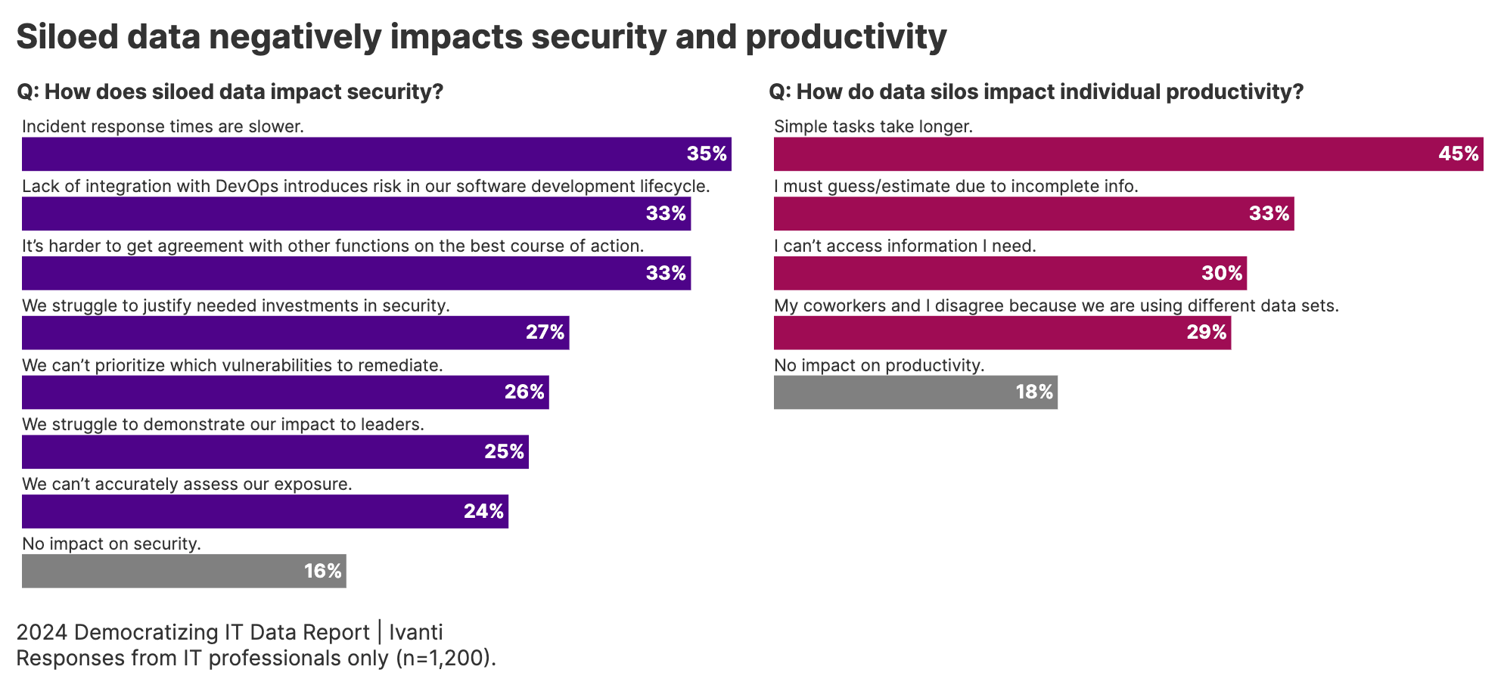
Democratising IT Data - Why it matters
IT
When cannot readily access data, it negatively impacts everything from
employee satisfaction to operational efficiency to business innovation.

Slide 6

IT Challenges
It’s this guy, right?
Analysts flooded with Too many Tickets?
Slow to drive Ticket Resolution? Does it take Minutes, Hours, or Days?
Are the IT staff utilised?
What are users experience with resolving issues?
How do you know if all your devices are protected?
How is your security team equipped to remediate systems that are vulnerable?​

Slide 7

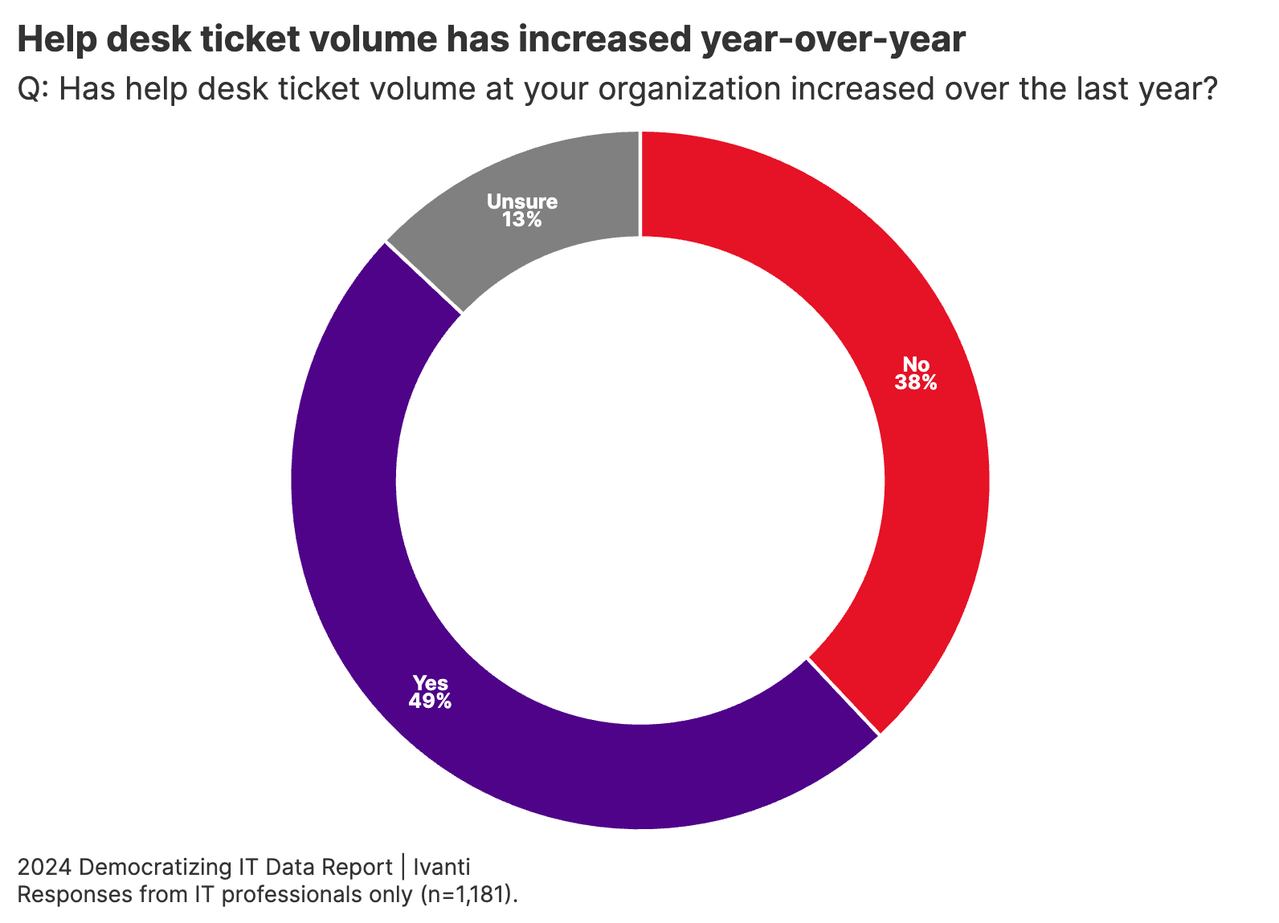
It is not getting better
Key finding
IT teams are increasingly overburdened

Slide 8



Challenges facing IT organisations drive siloed behaviour
GRC
Migrations
Security
Cloud
Service
Management
VDI
Asset
AV
Server
Help Desk
Desktop
Mobile
Patch
MSP
Innovation
IT
IT
IT
IT
MSP
MSP
Increased Risk
Lower User Satisfaction
Slow To Respond
Less Time to Be Strategic

Slide 9


Manage, prioritise and automate cybersecurity
$4.5M
85%
Visibility and analytics
of organisations experienced a successful cyberattack within the last 12 months
Average cost
of a data breach in 2022
Prioritisation
Protection
71%
>50%
Automation leading into AI
of IT and security professional find patching to be overly complex and time consuming
of cyber incidents will be caused by lack of talent or human failure by 2025
Sources – Ivanti research, IBM, CyberEdge
9
Notes:
9

Slide 10
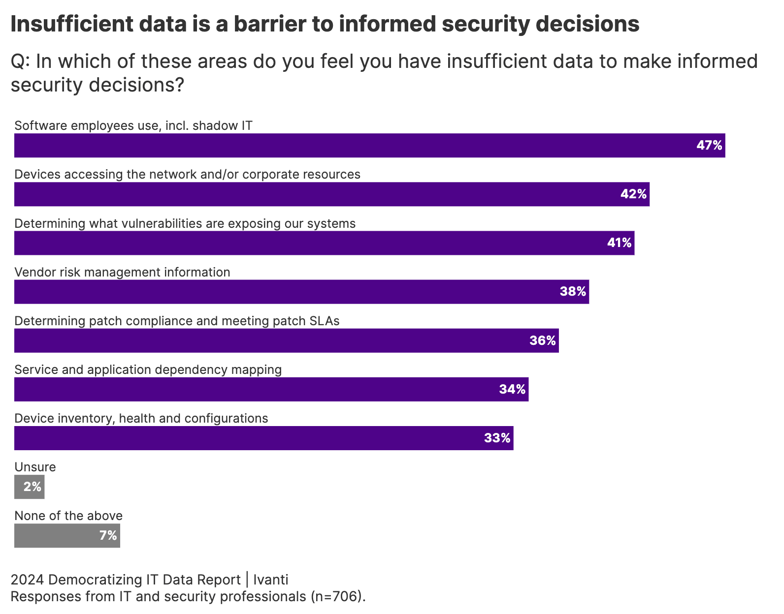
Key finding
Modern organisations are overwhelmed by data and struggle with major data accessibility problems.

Slide 11

Control and optimise IT investments​
26%
32%
Visibility
of top 3 SaaS solutions in organisations are underutilised by up to 49%
of IT professionals still use spreadsheets to track their devices
Compliance
and risk management
48%
1/3
Optimisation
of security professionals have low or moderate visibility into assets on their network
Service management processes have no visibility into asset information and relationships
Experience
Sources – Ivanti research, Gartner, enterprisemanagement.com
11
Notes:
11

Slide 12
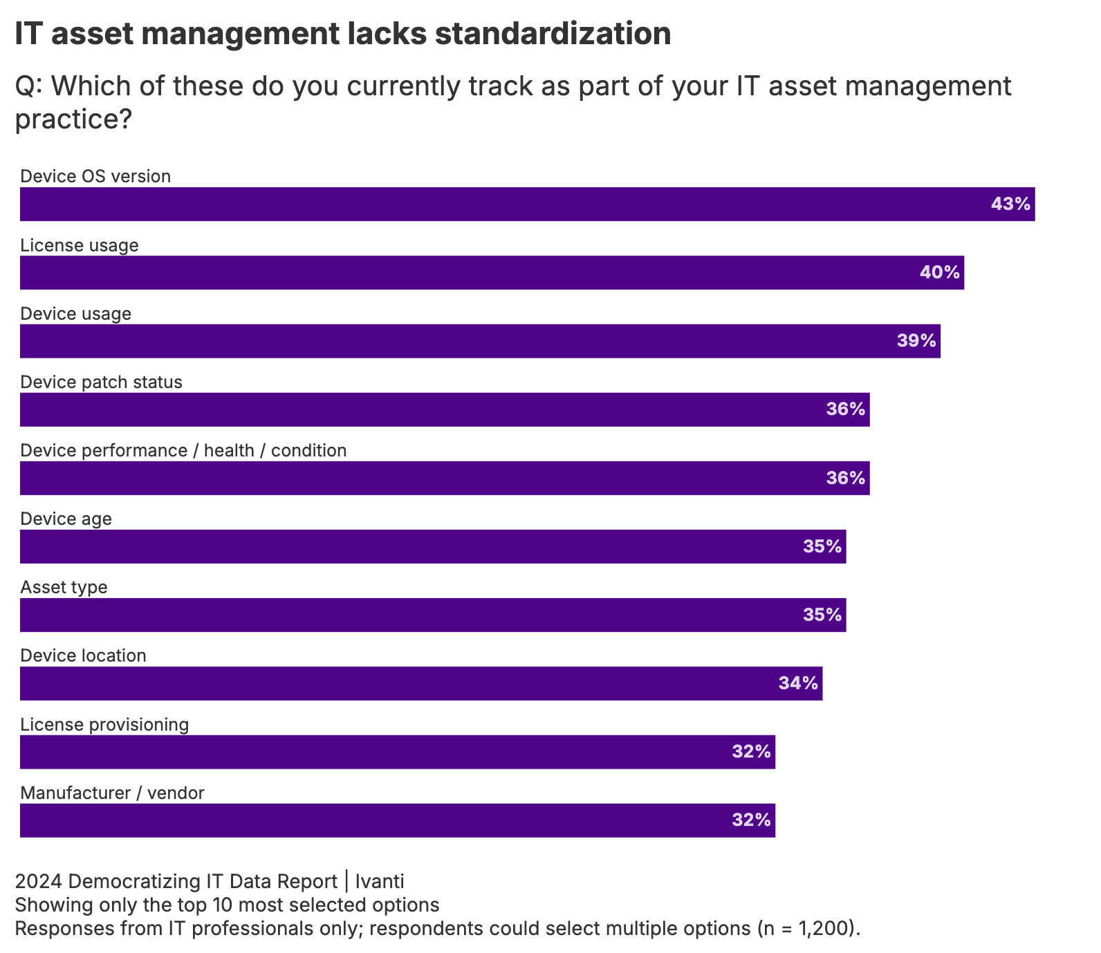
Key finding
IT data asset management lacks standardisation
Why it matters
Improving data standardisation and treating IT data as a strategic asset will boost cross-team collaboration and promote data-driven business decisions

Slide 13

Why it matters
Shadow IT puts organisations at risk of risks data leaks, compliance issues
and other vulnerabilities that ‌could have serious legal and reputational consequences. ​
1 in 3
organisations say
their current asset management solution does not track BYOD.
Key finding
Organisations suffer from serious data blind spots due to shadow IT, including unmanaged BYOD.

Slide 14




CIO / IT-Ops
CISO / Security
Drive innovation
Streamline operations
Improve digital employee experience
Proactively manage attack surface
Limit vulnerabilities & threat exposure
Improve secure employee behaviour & organisational culture
IT & Security Aligned
Reduce enterprise risk
Increase organisational resilience and efficiency
Improve employee experience & engagement
14

Slide 15
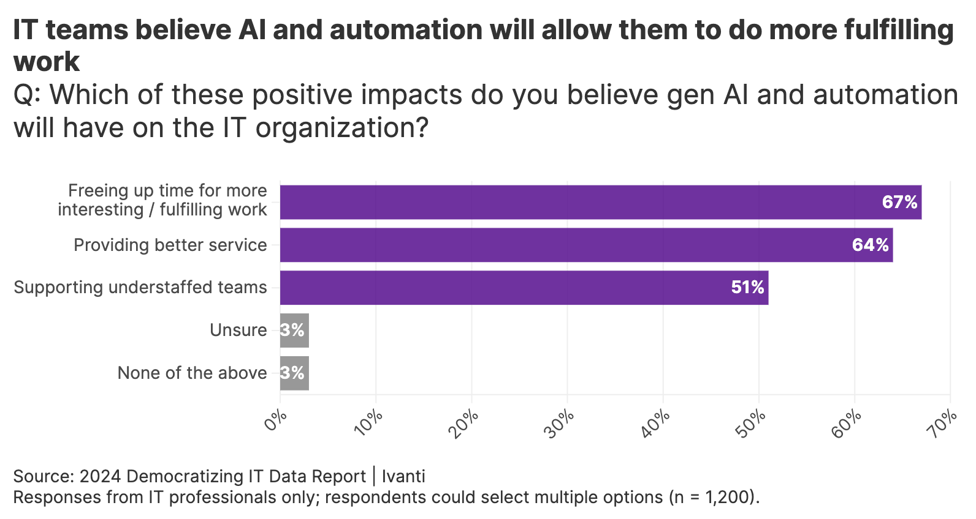
What will improve the situation
Intelligent Automation will reduce volume of calls.
Improved data management will empower IT to leverage AI to and do more meaningful work.

Slide 16
Improve your customer’s digital experience
Turn Minutes, Hours, and Days into SECONDS
We need Change in the IT Service Experience
BEFORE
With Intelligent Automation
Pre-Ticket
Automation
Post-Ticket
Automation
Health Degrades
User Self Troubleshoots
Analysts Assists User
Preventive Maintenance
Analyst
Shift-Left
Proactive Automation
Self Service
Issue Occurs
User Seeks Help
User Opens Ticket
Issue Detection
Ticket Classification

Slide 17

Better Experiences Lead to Better Outcomes
Improve Digital Experience
Productivity
Profitability
Security
Customer Satisfaction
Employee Retention

Slide 18


How Foundation augments current IT Management?
Ivanti Neurons Foundation
Insights
Actions
Actions
Discovery
Actions
Ivanti MDM
IT Systems Management
IT Systems Management
Ivanti EPM
IT infrastructure
No need to replace existing management systems – augment them to improve service experience.
Agile deployment, quick to realise value.

Slide 19
Thank you

